Slide 1

ESPERIENZA IN CHIRURGIA BARIATRICA UN VALORE AGGIUNTO NEL TRATTAMENTO DELLE NEOPLASIE DELL’UPPER GI? MOTIVAZIONI.
Federico Marchesi M.D. Ph.D.
Head of upper GI program
Azienda Ospedaliero-Universitaria di Parma
May 24, 2024

Slide 2



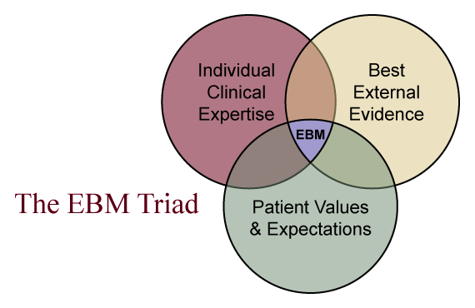
Notes:
Non è una diapo è un dogma.

Slide 3

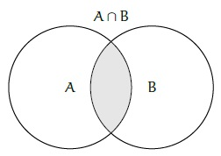


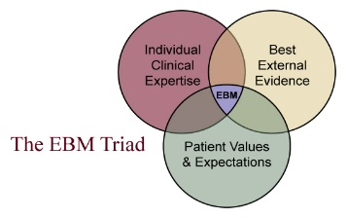

Bariatric for upper-onco MIS-sutures
Upper-onco for bariatric thoracic complications

Slide 4

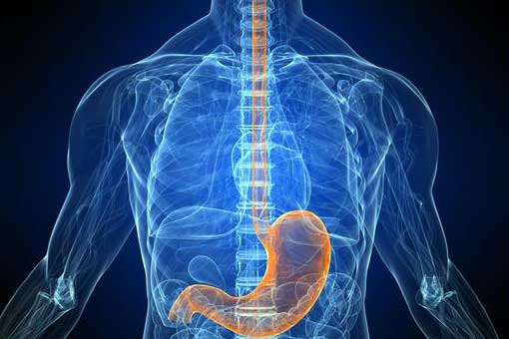



Bariatric surgery is an upper gi surgery?

Slide 5


Bariatric surgery is a surgical oncology ?
Safety
Surgical invasiveness
Oncological radicality

Slide 6


Bariatric patient is an upper gi patient?

Slide 7
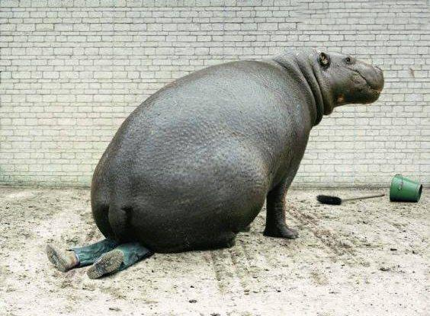
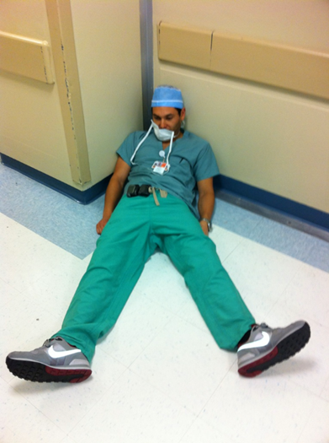


Slide 8
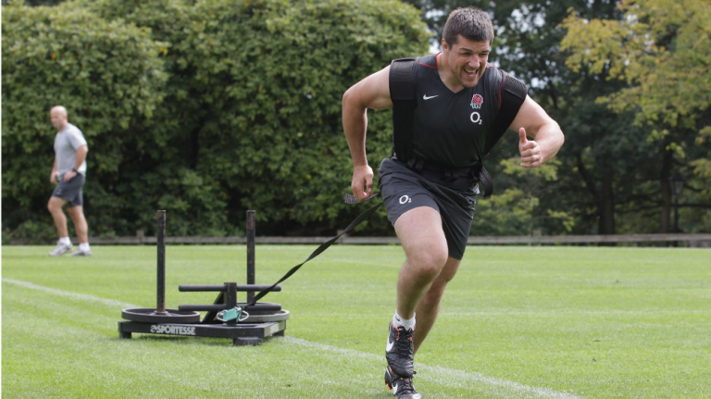
Physical resistance
Manual skill/ dexterity
Visual recognition

Slide 9

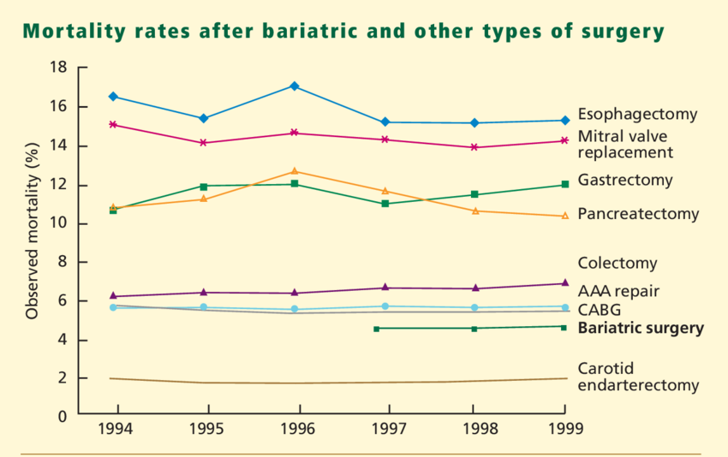
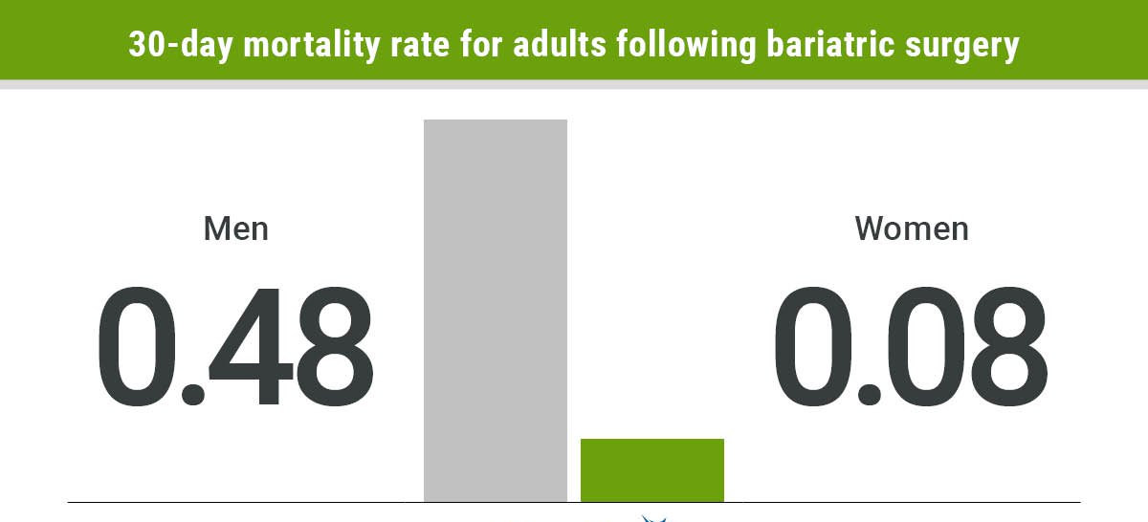

Slide 10

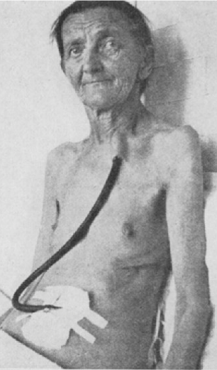
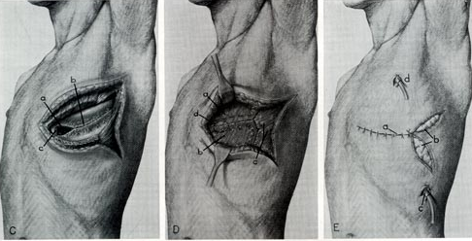
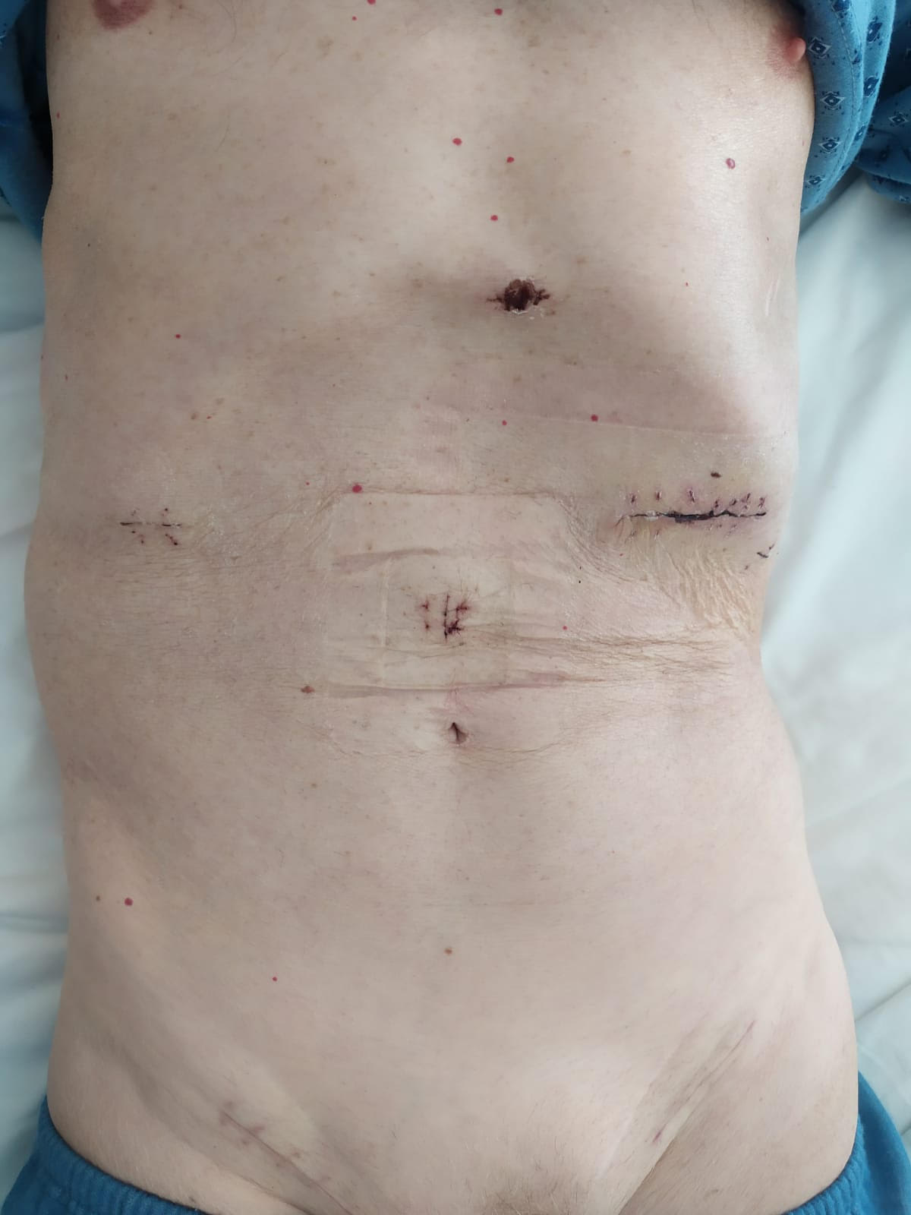
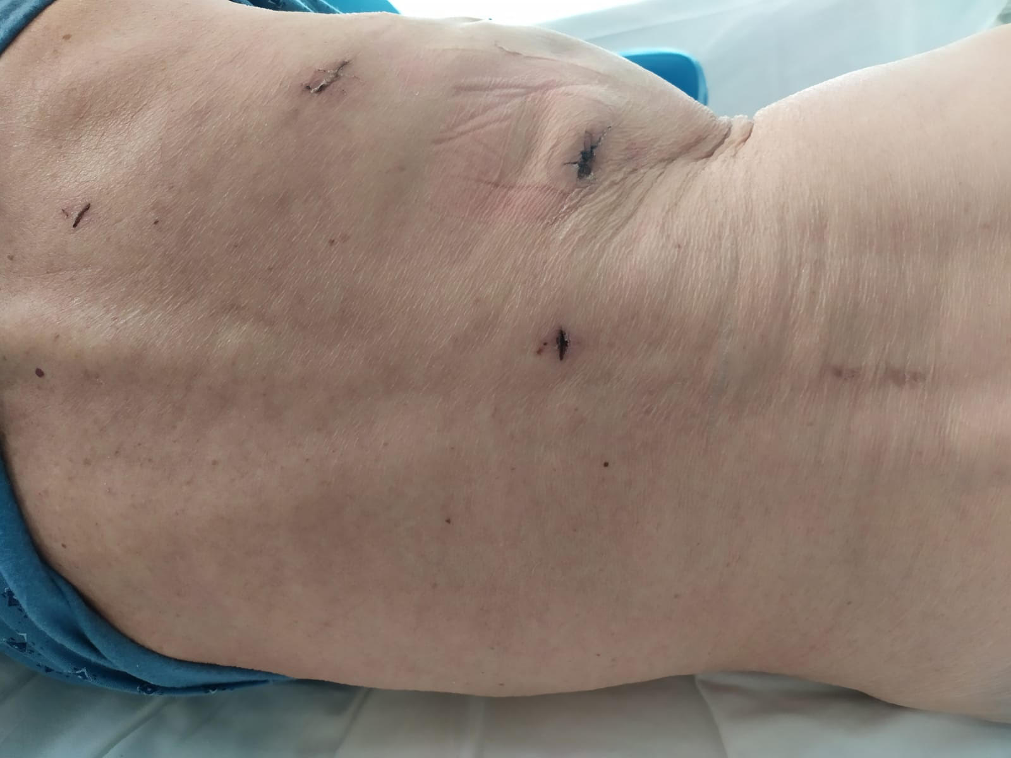


Slide 11
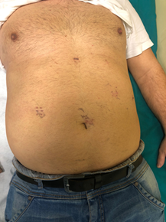

Notes:
56 vs 59

Slide 12


Slide 13

MIE
Approach
Pure (Thoraco-laparoscopic/transhiatal)
Hybrid (Thoracoscopic-laparotomic/Laparoscopic-thoracotomic)
Extension
Total (McKeown)
Subtotal (Ivor-Lewis)
Decubitus
Prone
Lateral
Technology
Laparoscopic
Robotic

Slide 14
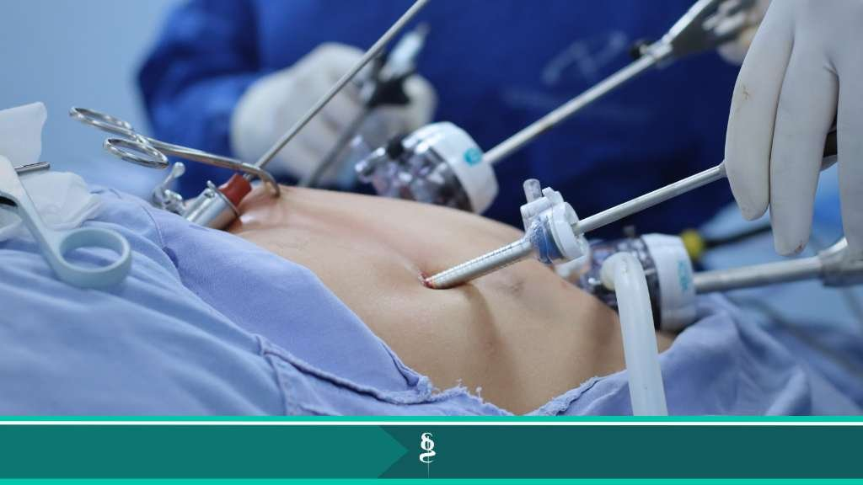
Minimally invasive approach in surgical oncology
Safety
Radicality
Benefits on postoperative outcome

Slide 15
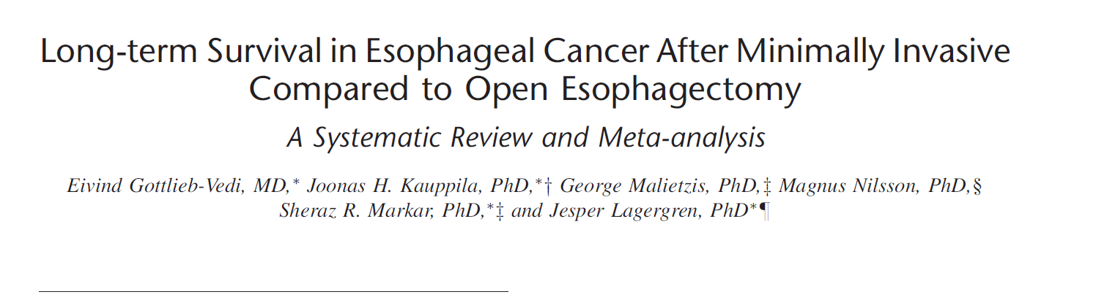
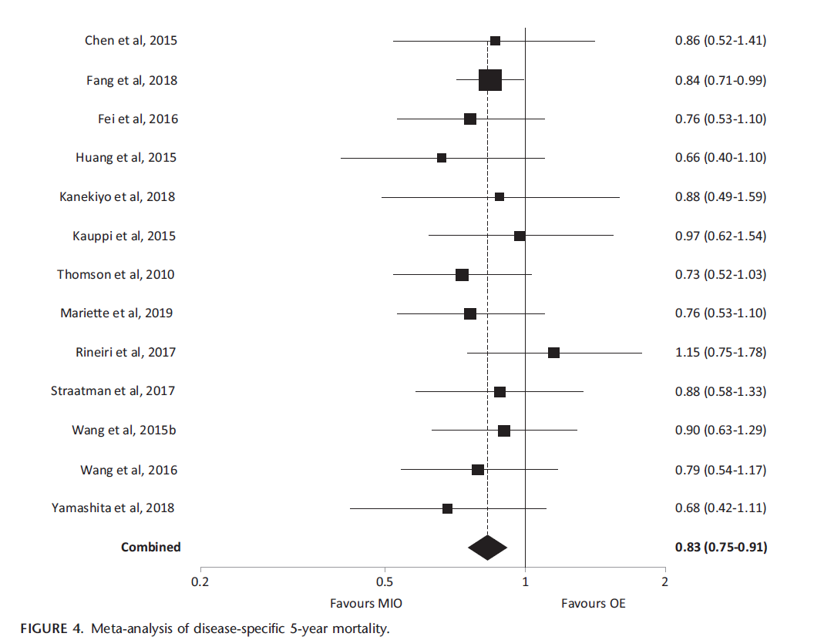


Slide 16
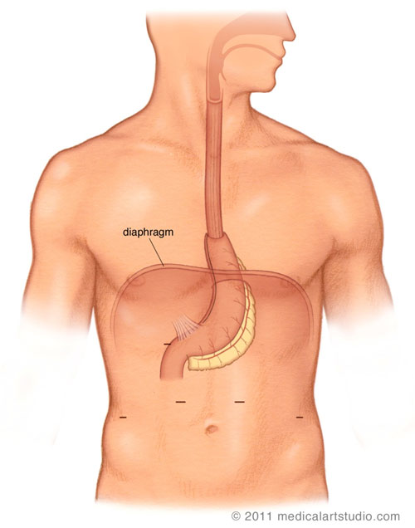

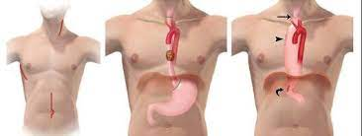
McKeown vs Ivor Lewis

Slide 17
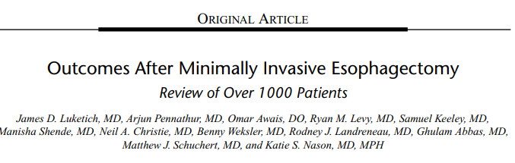


MIE 1996-2011
1996-2005 McKeown; by 2005 Ivor Lewis; by 2006 Ivor Lewis preferred approach
Stapled Anastomosis (EEA 28mm) preferred approach (79% in Mc Keown; 99% in Ivor Lewis)
Conversion 4.5%; > for adhesion; rarely emergent for bleeding
Lymphnodes resected 21 (> in Ivor Lewis, maybe for increasing experience)

Slide 18
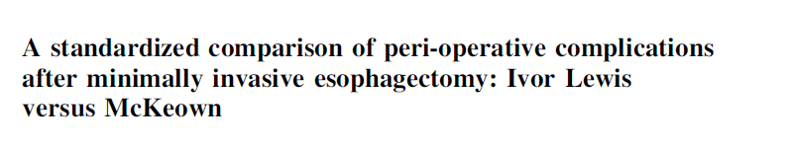


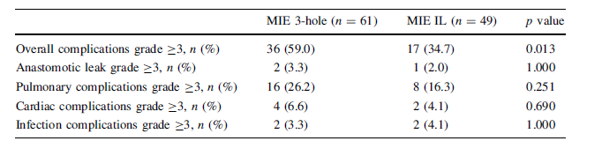
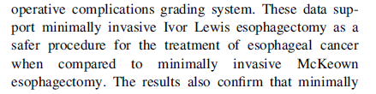

Slide 19
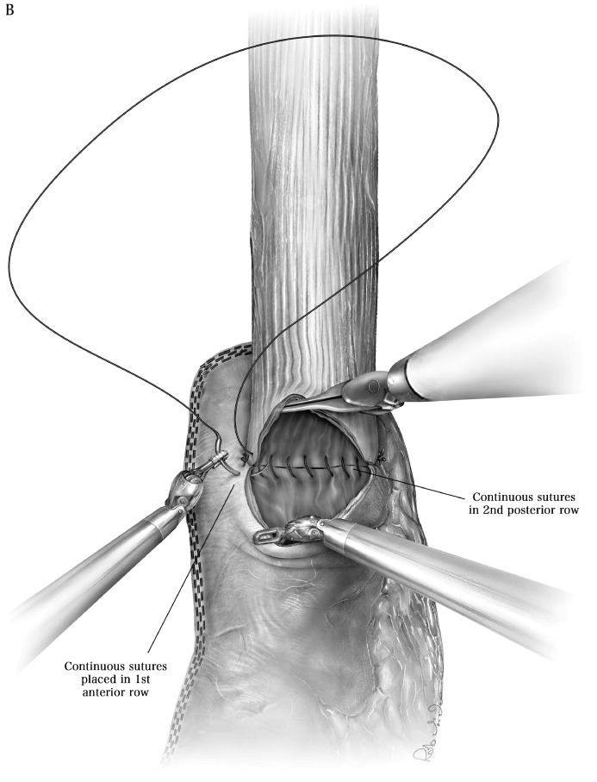

Minimally Invasive Ivor Lewis Esophagectomy
Nguyen et al Ann Thorac Surg 2001; 72:593-6
5 hours thoracoscopy
…………current limitation is the difficulty in creating the intrathoracic esophago-gastric anastomosis

Slide 20
Incidence and treatment of mediastinal leakage after esophagectomy: Insights from the multicenter study on mediastinal leaks
Risk Factors for Gastrointestinal Leak after Bariatric Surgery: MBASQIP Analysis: Data from 133,478 patients who underwent laparoscopic sleeve gastrectomy (n = 92,495 [69.3%]) and LRYGB (n = 40,983 [30.7%]) were analyzed. Overall leak rate was 0.7% (938 of 133,478).
Notes:
Abstract
Modified Minimally Invasive Ivor-Lewis Esophagectomy with Trans-hiatal esophageal transection
AIM: The minimally invasive approach for Ivor-Lewis esophagectomy (Ivor-Lewis MIE) technique is a challenging procedure for the technical difficulties in intrathoracic anastomosis. To decrease the complexity of MIE, we modified the technique by transecting the esophagus during the laparoscopic stage, via a trans-hiatal approach.
Methods: This revision of the procedure allows transabdominal specimen extraction with immediate frozen section examination prior to the thoracic stage. This latter stage is then made easier by the absence of the specimen in the operative ﬁeld, facilitating mediastinal nodes dissection and allowing technically easier intrathoracic esophagogastric anastomosis. In addition, the esophageal stump is further resected during the thoracic stage, granting a longer margin. The absence of a thoracotomy to extract the specimen should further reduce pulmonary morbidity.
Results: Fourteen patients underwent Ivor-Lewis MIE with the modified technique. Mean operative time was 436(±62) minutes, no conversion to open surgery was required and there was no anastomotic leak, whereas 1 post-operative chyle leak (7.1%) was detected and treated by conservative approach. Five patients (35.7%) developed pulmonary complications and 4 (28.6%) has clavien-dindo 3 complications, but no 90-days mortality was registered. ICU mean stay was 2.9(±1.8) days and the median length of stay was 11(IQR=5.5) days. Mean number of nodes retrieved was 34.9(±15.6), among which a mean of 5.8(±5.5) were mediastinal and the mean Lymph Node Ratio was 0.12(±0.12). The mean length of esophageal margin was 43.4(±13.5) mm. In 2 cases (14.3%) the frozen section examination of the esophageal margin obtained by the trans-hiatal transection appeared to be infiltrated by the tumor, in both cases the frozen section examination of the further esophageal resection, performed during the thoracic stage, resulted free from tumor. However, one of these cases (7.1%) resulted infiltrated by the tumor at definitive pathology result. After a mean follow-up of 16.8(±8.8) months, 5 patients (35.7%) have developed a recurrence, only 1 (7.1%) local recurrence. The median estimates DFS and OS were 13 months and 29 months, respectively.
Conclusion: The proposed revision of the Ivor-Lewis MIE procedure seems to be safe and feasible, with comparable outcomes to the traditional technique.

Slide 21
Factors influencing different leak rates between bariatric surgery and upper onco surgery
Patient paraneoplastic factors, age, obesity paradox, …
Procedure/treatment multi stage, neoadiuvant therapies, lymphoadenectomy,…
Surgeon specific skills, volumes,…
Bariatric background

Slide 22
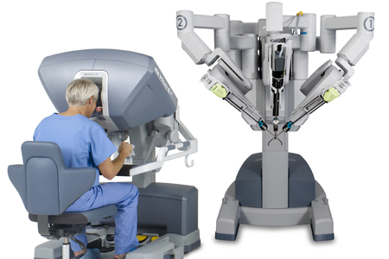

Can Robotic Surgery be the solution?
Combination of beneficial effects of minimally invasive surgery…
…with safety of open anastomosis
MIRO trial
TIME trial
Results from National Databases

Slide 23

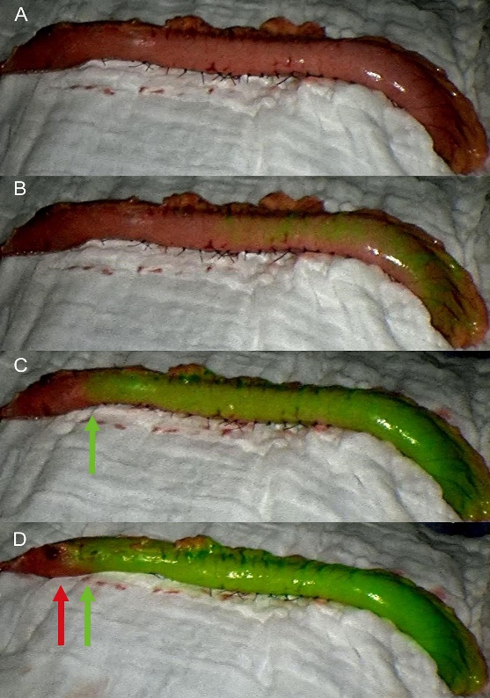
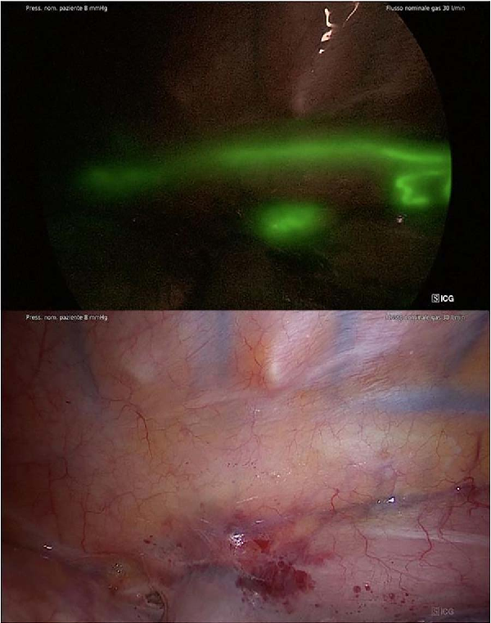
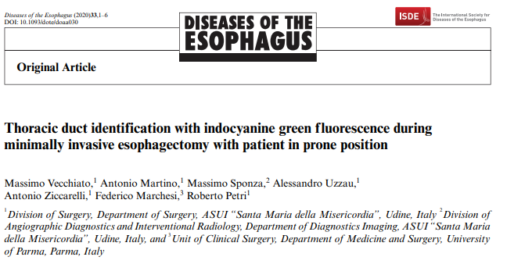

Slide 24
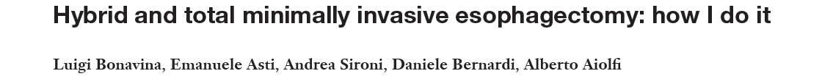
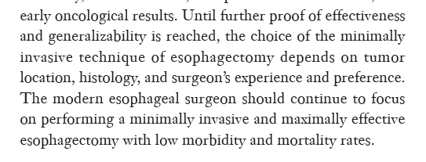



Slide 25

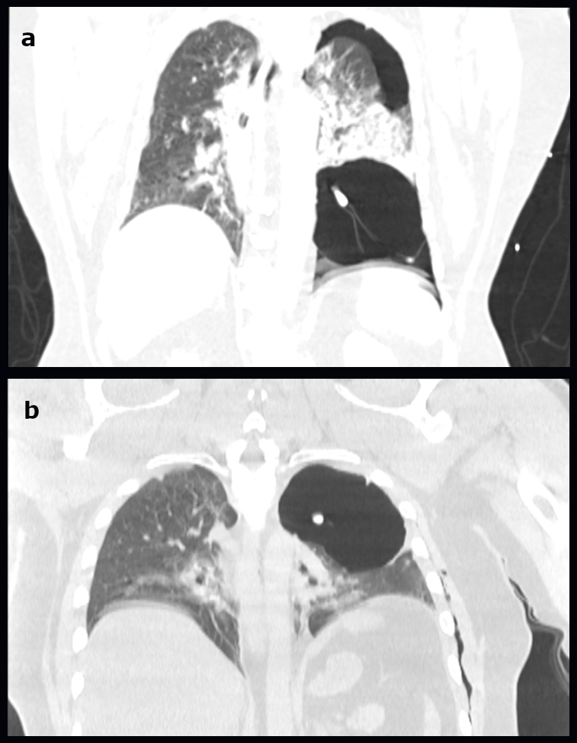
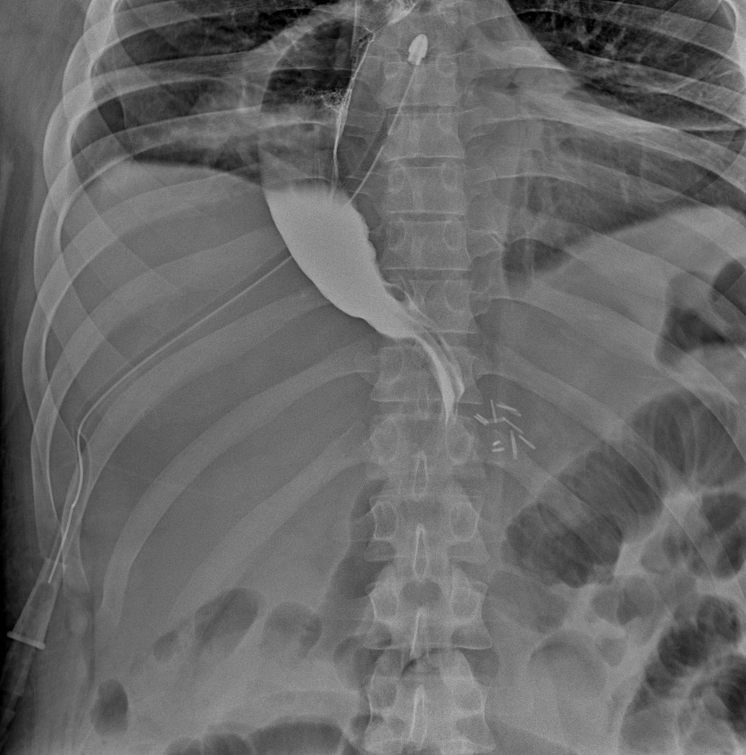

Slide 26

Grazie

